Slide 1

Adult Income Prediction
Team Scrapy
(Dec. 21, 2022)

Slide 2
OUR TEAM
Project Lead
Kwame Otchere
Assistant Project Lead
Shrey Gupta
Query Analyst
Ajisafe Kolade
Active Team Members
Adelusi Adegoke
Ayush Kumawat
Babarinde Mojeed
Jacobs Agyei
Nagendranath Vemishetti
Olaiya Olamibowale
Olalekan Adedokun
Richard Owusu
Barry Ugochukwu

Slide 3
PROBLEM STATEMENT
Leveraging the census data to understand and predict whether or not an individual will earn more or less than $50,000 per year

Slide 4
OUR APPROACH
Data wrangling
Data exploration
Feature Engineering
Encoding
Scaling
SMOTE
Model building
Model evaluation (prediction)

Slide 5
DATASET DESCRIPTION
The dataset (from Kaggle) is credited to Ronny Kohavi and Barry Becker and was drawn from the 1994 United States Census Bureau data
The dataset contained 32,351 observations and 15 variables; a mixture of categorical and numerical data types representing various demographic and economic factors
The columns were: age, workclass, fnlwgt, education, education_num, marital_status, occupation, relationship, race, sex, capital_gain, capital_loss, hours_per_week, native_country, income

Slide 6
DATA WRANGLING AND PRE-PROCESSING
The dataset contained some null values. Rows with null values were dropped
Columns in the dataset were renamed and restricted to alpha-numeric characters
Duplicate values were dropped
After the cleaning, the dataset had 30,139 rows

Slide 7
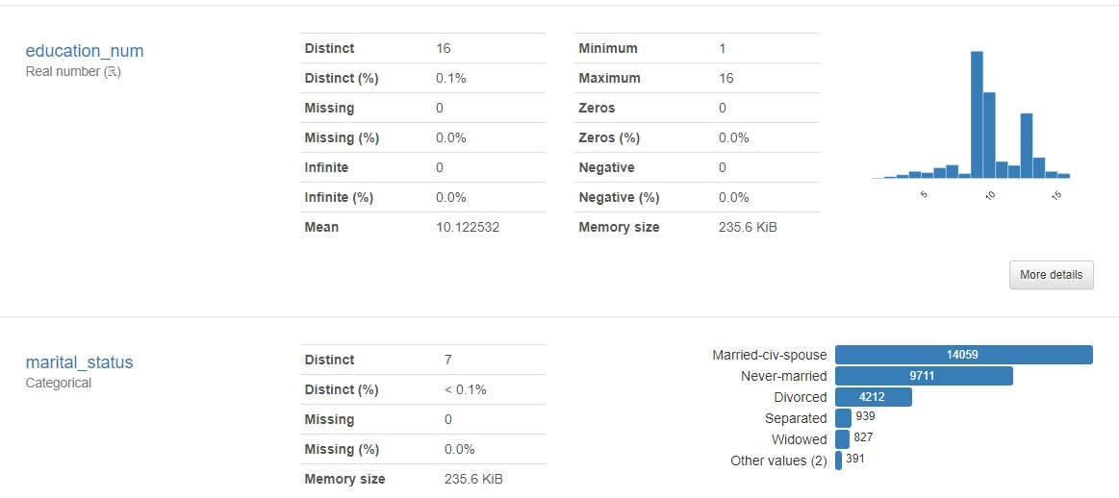
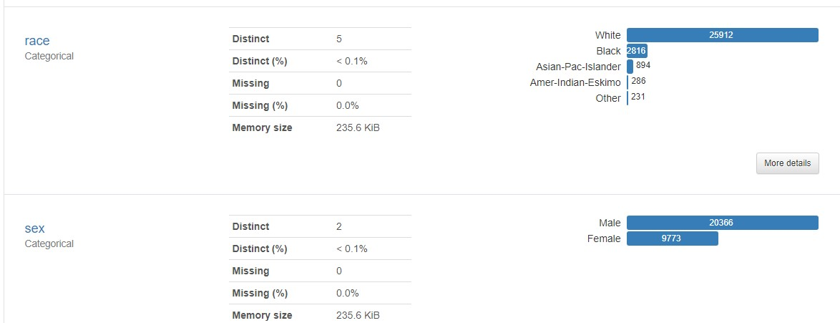
EXPLORATORY DATA ANALYSIS
Pandas Profiling was used for the EDA
Basic stats include:
The youngest and oldest age in the dataset were 17 and 90 respectively
There were 7 unique work classes within the dataset, with individuals working in the private sector representing a significant portion
85% of the observations were from whites
There were twice as many males as there were females

Slide 8
INSIGHTS: DEMOGRAPHIC
Most of the people who made above 50k were middle-aged adults (36 - 51 years)
A chunk of those who earned above 50k had 10-13 years of education, with a median value of 12 years, vs. 9-10 years for those who earned below 50k
The race with the highest percentage of observations earning above 50k was the Asian-Pac-Islander race (26.59%) followed by Whites (25.60%).
41% of Iranian natives earned above 50k, followed by French natives (41.38%).
Doctorate (74.09%) and Prof-school (73.44%) were the classes with the highest percentage of people earning above 50k.
There was a higher percentage of males earning above 50k (30.59%) as compared to females (10.96%)

Slide 9
INSIGHTS: ECONOMIC
People who earned above 50k worked for 40 - 50 hours, vs. 30 - 40 hours for those on the other end
Most people had 0 capital gains and losses, so all who had above USD 100 were classified as outliers
People who earned below 50k made more capital losses than those who made above 50k
The work class with most people earning above 50k were the two self-employed columns with about 55.73% and 38.65% of each class earning above 50k
Managerial executives (48.41%) and professional specialty (44.92%) were the occupations with the highest proportions of observations earning above 50k.

Slide 10
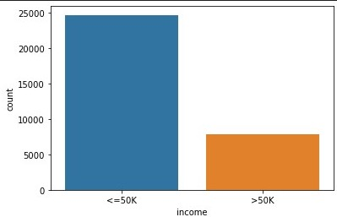
MODEL BUILDING: PRE-PROCESSING
Categorical features were encoded with a one-hot encoder
The dataset was mildly imbalanced (minority class was about 24%)
SMOTE (Synthetic Minority Oversampling Technique) was applied to balance the dataset
The numeric columns were scaled with a min-max scaler

Slide 11
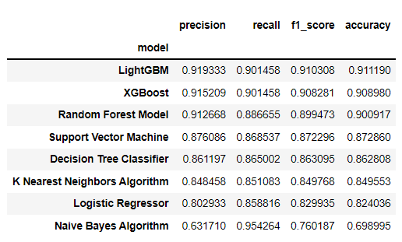
MODEL TRAINING AND EVALUATION
The dataset was split into train and test sets for modelling
The train set was split to train and test to select the top models
The top models were tested on the original test set
The models were evaluated using: accuracy, precision, recall and F1-scores.

Slide 12
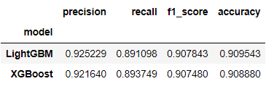
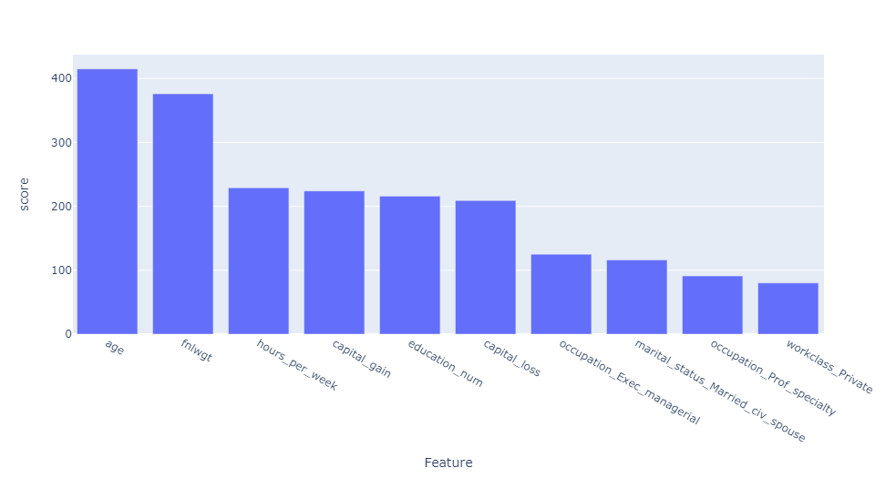
MODEL SELECTION
The LightGBM model was the best performer on both training and evaluation sets
The most important features were:
age
final weight
hours per week
capital gain / loss
number of years in education

Slide 13
SUMMARY
The LightGBM model was the best performing model
Age, hours per week and education levels were most influential variables for income class prediction
More observations will help add diversity to the dataset and give more context to findings

Slide 14
Thank You
Kwame Otchere

